Slide 1

BRACKET CHALLENGE
Can a model beat the biggest College Basketballs fans?

Slide 2
WHAT IS MARCH MADNESS?
NCAA D1 Basketball Championships
64 teams (different leagues), 6 rounds, one-and-done
36.5 million people filled out brackets in 2022
Odds of perfection - 1 in 9.2 quintillion
Warren Buffet offered $1B for a perfect bracket
Notes:
The challenge - it is often a game of runs. The unique one-loss eliminations leave room for chaos. Everyone loves a good underdog, and when an upset happens, it’s something you don’t want to miss. Last year we saw a #15, St. Peter’s, take out #2 basketball giant Kentucky. My boyfriend’s father, an avid college basketball fan, had his bracket destroyed in the first round when this happened. If a basketball fan can’t see something like this coming, can a model?

Slide 3
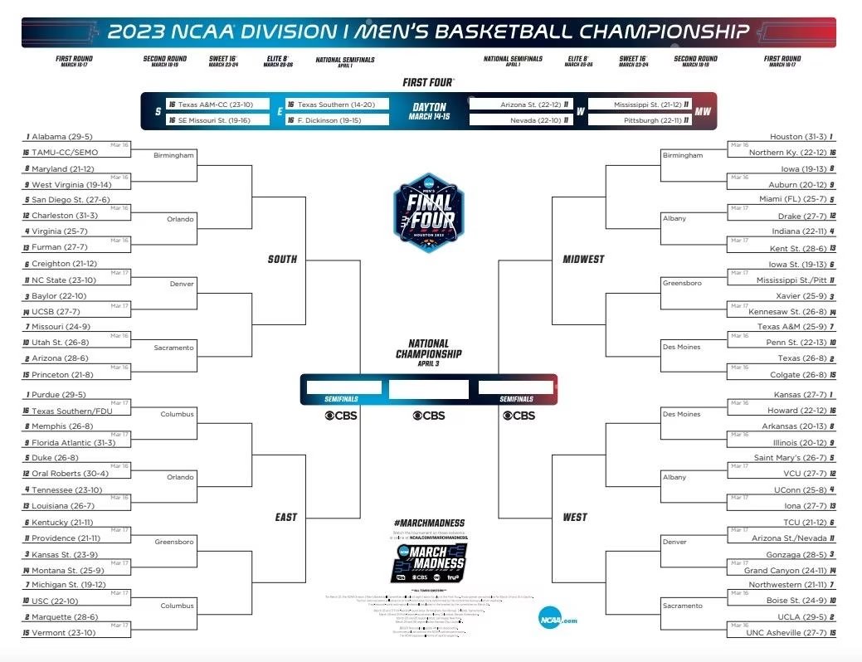
The Bracket

Slide 4
Potential Approaches
THE DATA
Team Data (2022-2023 Year or Historical Franchise Performance)
Player Data (2022-2023 Year or Historical)
Historical March Madness Tournament Results - Seedings
THE MODEL
Head-to-head matchups
Overall rankings (re-run each round or not)
THE STRUCTURE
Weighting recent games heavier
Type of model

Slide 5
Data Collection
NCAA Site has exportable stats
Following Datasets:
NCAA Stats (Conference, Net Rankings, Quadrants, etc.)
Field Goals (Rank, FGM, FGA, FG%)
FG Opponent (Rank, OPP FG, OPP FGA, OPP FG%)
Free Throws (Rank, FT, FTA, Avg)
Threes (Rank, GM, 3FG, 3FGA, 3FG%)
Scoring Margin (Rank, PTS, PPG, OPP PTS, OPP PPG, SCR, MAR)
Rebounds (Rank, ORebs, DRebs, REB, RPG)
Assists & Turnovers (Rank, AST, TO, Ratio)
Created dataset with bracket teams (21/22 & 22/23)
Clean team names & merge
Result: 2 dfs with 68 teams, 57 variables

Slide 6
Modelling Rationale
Goal - try to do something unique
Lots of trial & error (lm’s, glm, pca, etc.)
Train on 21/22 (with tournament results) and test (predict) on 22/23

Slide 7
Training Models
LM (Backwards Selection) -
Residual standard error: 3.632 on 22 degrees of freedom
Multiple R-squared: 0.9652, Adjusted R-squared: 0.9003
F-statistic: 14.87 on 41 and 22 DF, p-value: 3.309e-09
RF (Ranger) -
Type: Regression
Number of trees: 5000
Sample size: 64
# of independent variables: 54
Mtry: 7
Target node size: 5
Variable importance mode: impurity
Splitrule: variance
OOB prediction error (MSE): 91.9587
R squared (OOB): 0.3050238

Slide 8
Testing Models
Training Data - Ranking range from 1 to 33 (predicts in which round the team will lose)
LM - Ranking range from 0.6 to 36
RF - Ranking range from 12 to 30
Creating Brackets - Start from bottom-up and ensure worst teams are ‘losers’
Conflicts:
LM - 7 in first round
RF - 1 in first round
Model Prediction Difference:
Mean = 12.53
SD = 10.47

Slide 9

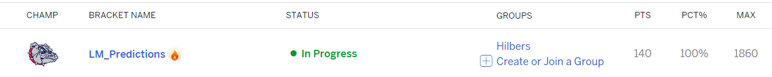
Results
4 Brackets:
LM
RF
Highest Seeds
ESPN ‘Smart’

Slide 10
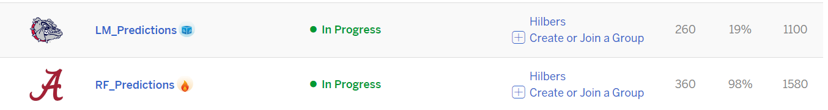
THANK YOU

Slide 11
2021/22 MM Tourney Data
Round | Number of Teams Losing in Round | Ranking Value
Round of 64 | 32 | 33
Round of 32 | 16 | 17
Sweet 16 | 8 | 9
Elite 8 | 4 | 5
Final 4 | 2 | 3
Finals | 1 | 1, 2

Slide 12
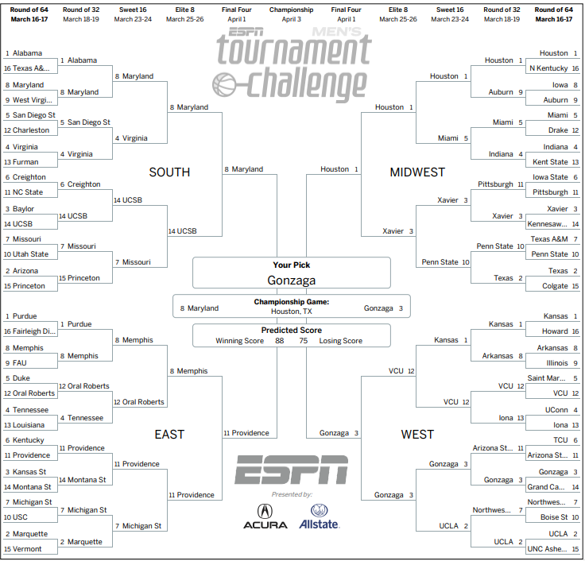
LM Bracket

Slide 13
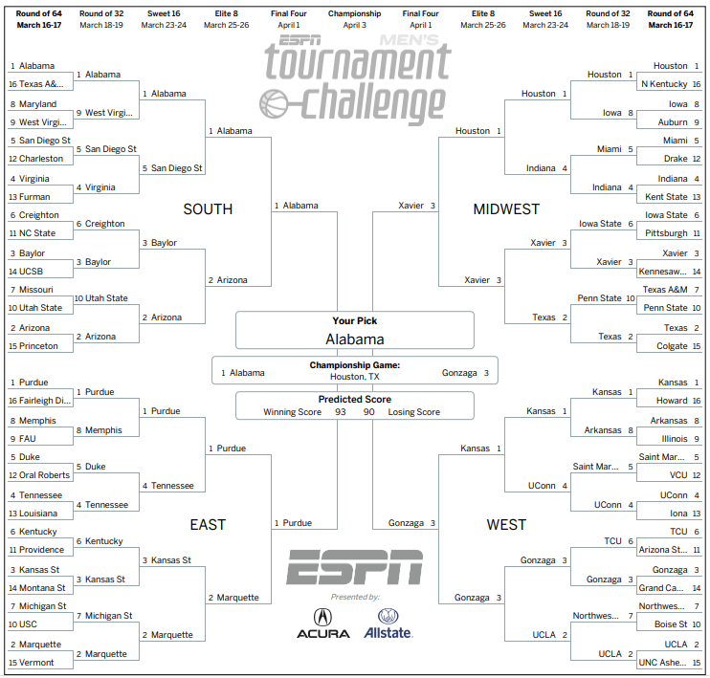
RF Bracket

Slide 14
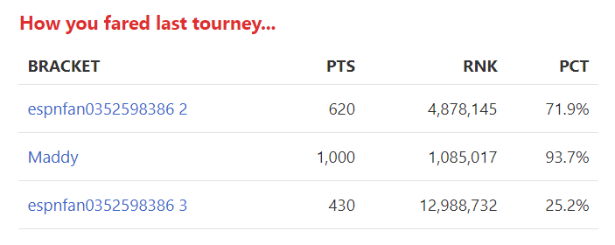
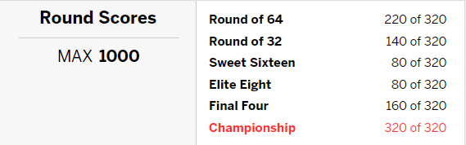
Last Year’s Results
Notes:
So, here are my brackets from last year. My top bracket, the one in the middle, was the bracket I entered in my group contests. I selected teams mainly because they were either highly ranked or I had heard of the school before. One main ‘technique’, if you can call it that, is I have a lot of friends who went down south on scholarship to run, so I picked their schools in this bracket. The #2 bracket is simply the top seeds being picked each time, and the #3 bracket is the ‘ESPN Smart Bracket’ which is some model that they have built to make predictions. Clearly it didn’t do well.
I am not a basketball fan. I am always down to watch a good sports game and the chaos of March Madness is hard to resist. Surprisingly, I won my group contest and fared quite well overall with zero knowledge or research.
I would say I am pretty knowledgeable about hockey, yet, I consistently underperform with Stanley Cup predictions. I would attribute that to my emotional feelings, a hopeless love for the Leafs and deep hatred for the Boston Bruins
This year, I also don’t know anything particular about the March Madness teams and I have no emotional attachments. I want to know if I can use the data to better predict the results.

